Slide 1
CSC 362: System Programming
Linux Environment
Original slides by: Amitabha Dey
Adapted by: Dr. Richard Johnson
Department of Computer Science University of North Carolina at Greensboro

Slide 2

Status Check
Run C/C++ code in VScode
Preprocessor directives
Source code compilation process
C: Control Structures
More C: Continue, extern, sizeof, etc
What we will cover today
Terminal Commands
Basic Navigation Commands
File Manipulation Commands
Environment Variables

Slide 3

Understanding the Terminal GUI vs CLI
GUI (Graphical User Interface)
Visual Interface: Users interact with the system through graphical elements like windows, icons, and menus.
User-Friendly: Easier to learn and use for beginners.
Limited Control: Typically offers less granular control compared to the CLI.
CLI (Command Line Interface)
Text-based Input: Users type commands to perform specific tasks.
Flexibility and Power: Offers more control and flexibility over the system.
Scriptability: Allows automation through scripting (e.g., Bash scripts).
Efficiency: Often faster for experienced users, especially for repetitive tasks.

Slide 4
Understanding the Terminal The shell (bash, zsh, cmd, etc)
Command Prompt (cmd)
The traditional command-line interpreter for Windows, available since the early versions of the OS.
Features:
Basic Shell: Provides a text-based interface for running batch scripts, executing commands, and managing files.
Compatibility: Limited in features compared to PowerShell, but still widely used for basic tasks.
Simplicity: Easier for basic operations but lacks the advanced capabilities of PowerShell.
Bash (Bourne Again Shell):
The most widely used shell, especially in Linux distributions.
Features:
Scripting: Extensive support for writing shell scripts.
Command History: Ability to recall and reuse previous commands.
Tab Completion:
Auto-completion for file names and commands.
Portability: Available on most UNIX-like systems.
Zsh (Z Shell)
An extended version of Bash with more features and customization options.
Features:
Enhanced Tab Completion: More advanced and context-aware than Bash.
Theme and Plugin Support: Customizable with themes (e.g., Oh-My-Zsh) and plugins.
Better Scripting Features: Improved handling of arrays and globbing.

Slide 5
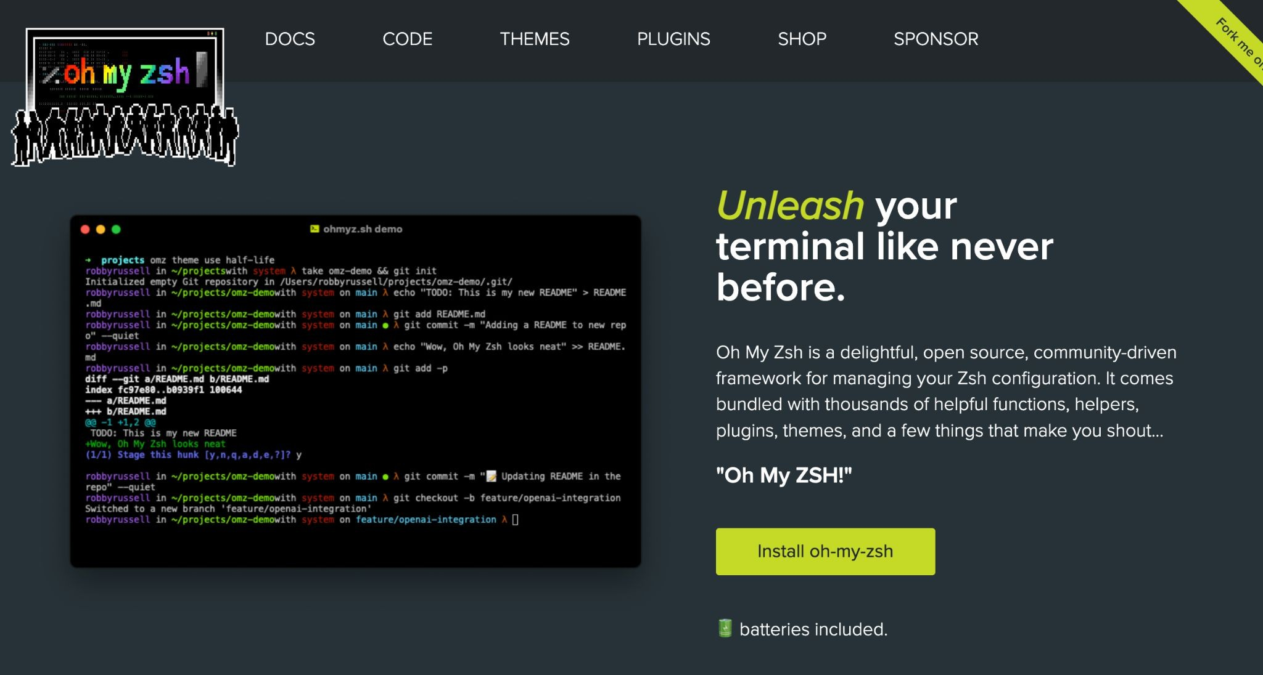
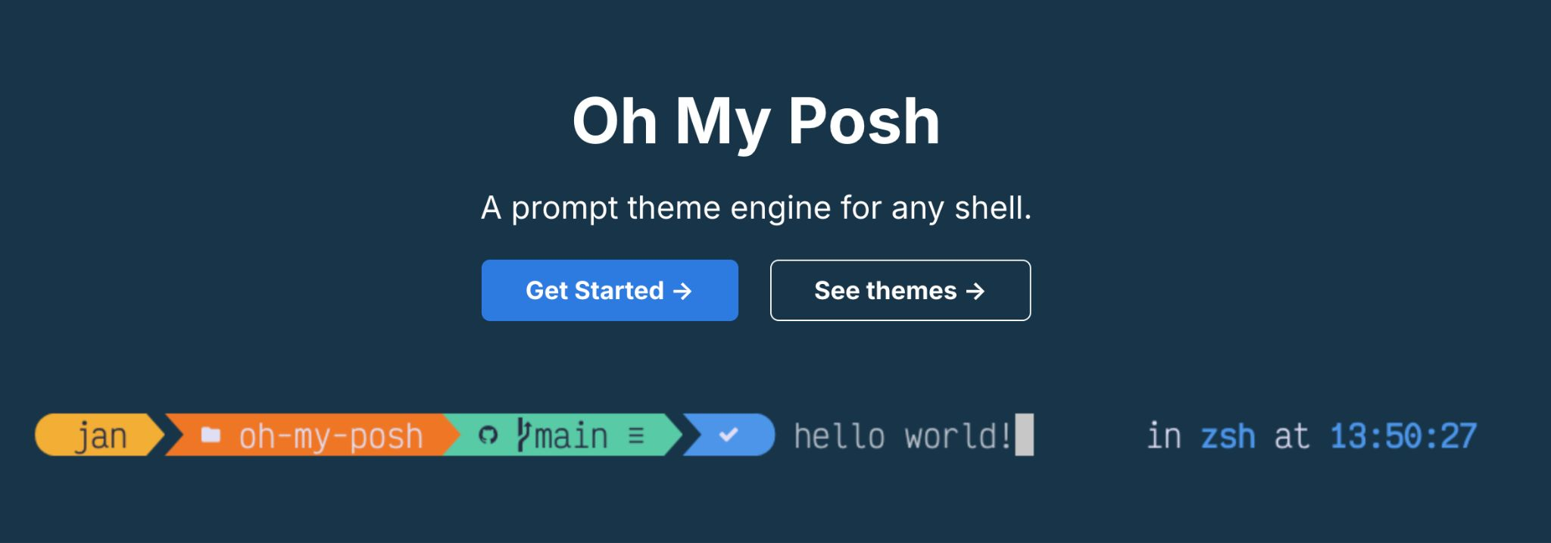
Enhance VS Code Terminal (Optional)
Alias | Git Command
gst | git status
gl | git pull
gp | git push
ga | git add
gcmsg | git commit –m
gco | git checkout
Notes:
Oh My Zsh is an open-source, community-driven framework designed to help you manage your Zsh configuration.
It provides a collection of pre-built scripts, sensible defaults, and a modular architecture for themes and plugins.
Key Benefits:
Ease of Setup: It provides a streamlined way to configure Zsh without needing deep knowledge of shell scripting.
Theming: You can easily change your terminal's appearance using over 150 built-in themes.
Productivity Plugins: It includes over 300 optional plugins for tools like Git, macOS, Docker, and Node.js.
Auto-Updates: A built-in tool helps you keep your configuration and plugins up to date with the latest community improvements.
The Git Plugin Features
Since you were just working with Git, the Git plugin is one of the most popular features. It provides functions and nearly 200 aliases to speed up your workflow:
Alias - Full Git Command
gst - git status
gl - git pull
gp - git push
ga - git add
gcmsg - git commit –m
gco - git checkout

Slide 6
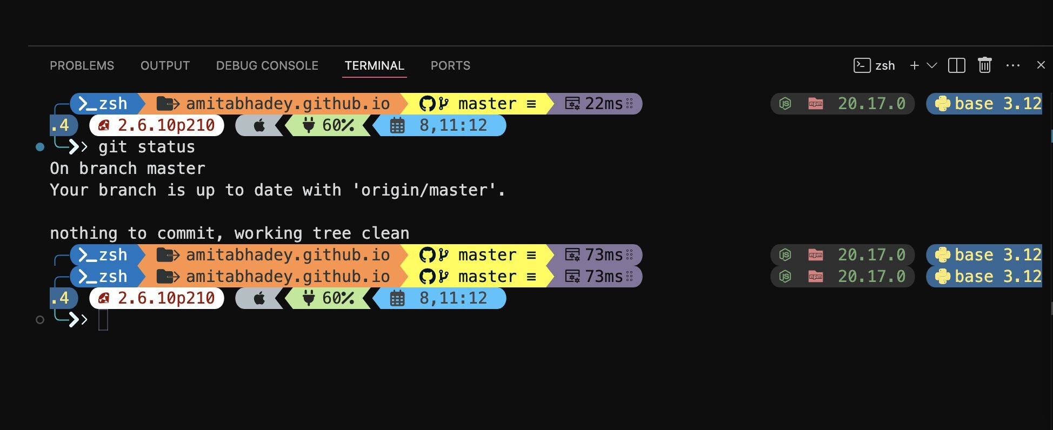
Enhance VS Code Terminal (Optional) (cont.)

Slide 7
Basic Navigation Commands
ls: Lists the contents of the current directory.
ls -l: Lists the contents of the directory in a detailed (long) format
ls -lh: Lists the directory contents in long format, with file sizes displayed in a human-readable format (e.g., KB, MB).
ls -lt: Lists the contents in long format, sorted by modification time (newest first).
ls -lS: Lists the contents in long format with file sizes shown in blocks, sorted by file size.
ls -a: Lists all contents, including hidden files (those starting with a dot).
pwd: Prints the current working directory (shows your current location in the filesystem).
which ls: Shows the path to the executable file for the ls command (useful to check where a command is located).

Slide 8
File Manipulation Commands
cd: Changes the current directory to the user's home directory.
cd <directory>: Changes the current directory to the specified <directory>.
cd ..: Moves up one level to the parent directory.
cd ../..: Moves up two levels to the grandparent directory.
mkdir: Create folder
rmdir: Remove folder
mv old_folder_name new_folder_name: Rename folder names
touch filename.txt: Creates an empty file named filename.txt or updates the timestamp if it already exists.
open filename.txt: Open the empty file
cat filename.txt: Displays the contents of filename.txt on the terminal.

Slide 9
Environment Variables
echo Hello: Prints the text "Hello" to the terminal.
food=pizza: Assign value to a variable
echo what food do I want\? $food : Print the variable
echo $HOME: Displays the path to the current user's home directory.
echo $USER: Prints the username of the current user.
echo $PATH: Displays the current user's PATH environment variable (directories where the system looks for executable files).

Slide 10
How to Create and Run a Bash Script
A Bash script is simply a text file containing a series of commands that the shell executes in sequence. Follow these four essential steps:
Create the File Open your terminal and create a new file with the .sh extension. Command: touch myscript.sh Open in Editor: nano myscript.sh (or use VS Code/Vim)
Add the "Shebang“ The first line of every script must tell the system which interpreter to use. The Line: #!/bin/bash Purpose: Ensures the script runs in the Bash shell even if the user is using a different shell (like Zsh).

Slide 11
How to Create and Run a Bash Script (cont. 1)
Write Your Commands Add the logic you want to automate.
#!/bin/bash
# This is a comment
echo "Hello, $(whoami)!"
echo "The current directory is: $(pwd)"
Notes:
Quick Tips:
Comments: Use # to document what your code does.
Variables: Define them without spaces: NAME=“Alice".
Exit Codes: Use exit 0 at the end to signal that the script finished successfully.
$ symbol is primarily used for Expansion.
It tells the shell to look at what follows and replace it with a specific value.
Setting: NAME="Alice"
Accessing: echo $NAME (Outputs: Alice)

Slide 12
How to Create and Run a Bash Script (cont. 2)
Grant Execute Permissions By default, new files aren't "executable" for security reasons. You must change the file mode. Command: chmod +x myscript.sh
Execute the Script Run your script from the terminal using the relative path. Command: ./myscript.sh

Slide 13
Special Parameters (Built-in Variables)
Bash uses the dollar sign combined with specific characters to give you information about the script's environment:
Syntax | Description
$0 | The name of the script itself.
$1, $2... | Positional arguments passed to the script.
$# | The number of arguments passed to the script.
$? | The exit status of the last executed command (0 usually means success).
$$ | The Process ID (PID) of the current shell.

Slide 14
Arithmetic Expansion
To perform math inside a script, you use double parentheses preceded by a dollar sign.
Syntax: $(( expression ))
Example: echo $((5 + 3)) (Outputs: 8)

Slide 15
A Word on Quotes
Double Quotes (" "): The shell will still expand the $ (e.g., "Hello $USER" becomes "Hello Alice").
Single Quotes (' ‘): The shell treats the $ literally (e.g., 'Hello $USER' remains 'Hello $USER').

